Slide 1
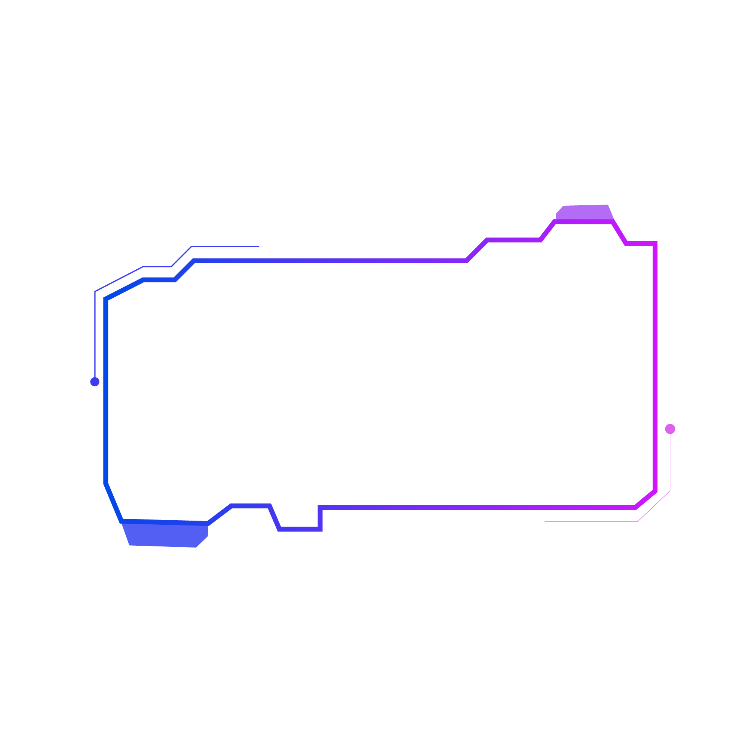

End-to-End CI/CD Pipeline for Web Application with Docker, Jenkins and Automated Monitoring
Submitted by :
Apurva Lagad (240844223004)
Srushti Bhosale (240844223007)
Rohini Khandare (240844223040)

Slide 2
Introduction
Modern web applications require fast, reliable, and secure deployment processes.
Manual deployment leads to errors, security vulnerabilities, and inefficiencies.
CI/CD pipelines automate build, test, security scanning, and deployment.
This project focuses on integrating security into an automated CI/CD workflow.

Slide 3

Challenges in Traditional Deployment:
Manual effort required for software integration, testing, and release.
Security risks due to lack of automated vulnerability scanning.
Inconsistent environments leading to "works on my machine" issues.
Slow release cycles affecting agility and innovation.
Problem Statement

Slide 4

Proposed System
A fully automated CI/CD pipeline to ensure continuous integration and secure deployment.
Uses tools like Jenkins, Docker, Kubernetes, SonarQube, Trivy, Prometheus, and Grafana.
Automates security checks, reducing vulnerabilities before deployment.
Ensures scalability, monitoring, and self-healing in production environments.

Slide 5
Git: Manages source code history and facilitate collaborative software development.
Jenkins: Automates build, test, and deployment.
Docker: Containerizes applications for consistency across environments.
Kubernetes: Manages container orchestration and scaling.
SonarQube: Performs static code analysis to detect vulnerabilities.
Trivy: Scans container images for security flaws.
Prometheus & Grafana: Provides real-time monitoring and logging.
Tools and Technologies

Slide 6
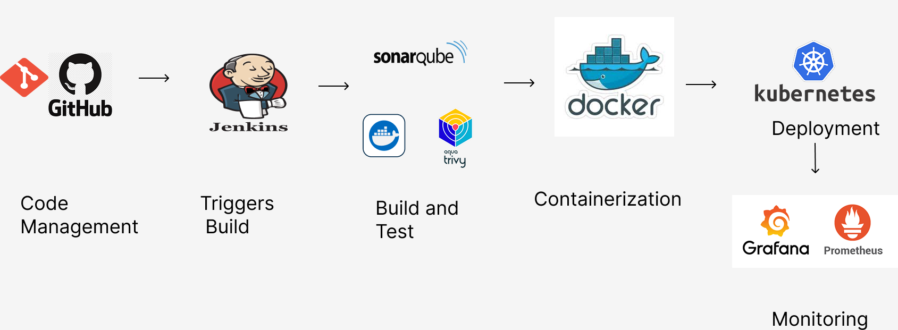
System Architecture
.

Slide 7
Stages of CI/CD Pipeline
Code Integration and Version Control – Developers push code to GitHub.
Build Automation and Compilation– Jenkins automatically pulls the latest changes and initiates the build process
Automated Testing– Automated unit and integration tests run.
Static Code Analysis and Security Scanning– SonarQube and Trivy check for vulnerabilities.
Containerization and Image Deployment- The application is packaged into a Docker container to maintain consistency across different environments.
Deployment to Kubernetes– Kubernetes deploys containers to production.
Monitoring & Logging – To maintain visibility into application performance and infrastructure health, Prometheus and Grafana are integrated for real-time monitoring and log analysis.

Slide 8
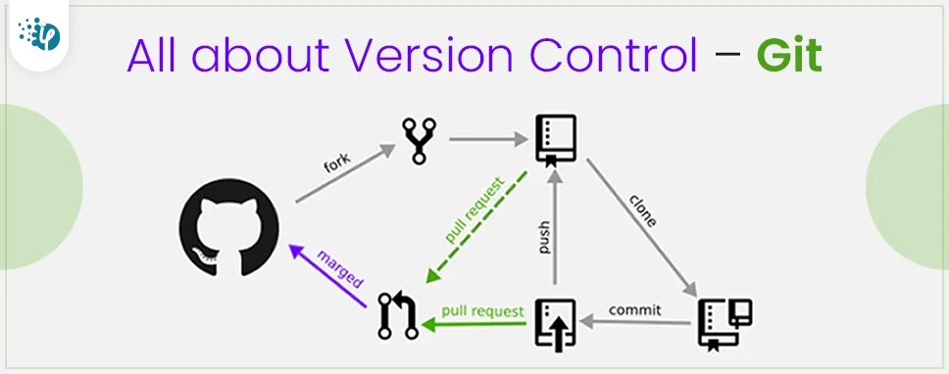
Code Integration and Version Control
Git is a distributed version control system (VCS) designed to manage source code history and facilitate collaborative software
development.
Key features of Git:
Distributed Architecture
Branching and Merging
Commit History
Collaboration

Slide 9
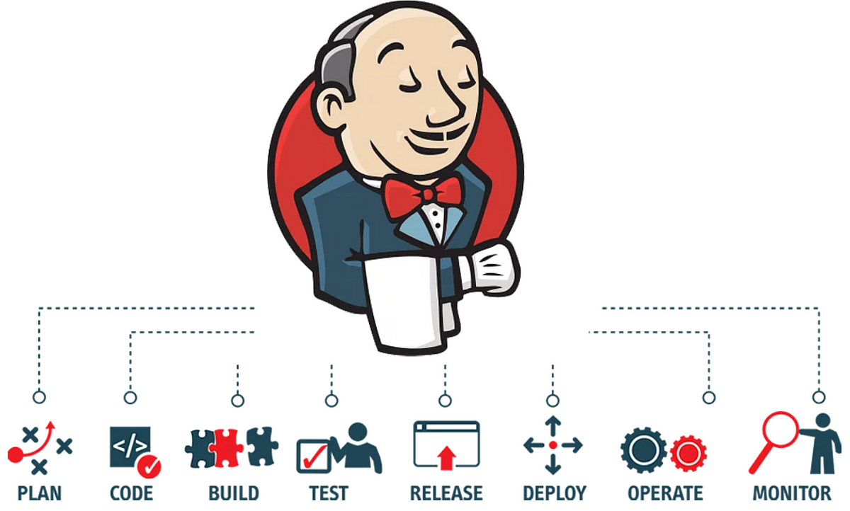
Build Automation and Compilation
Jenkins is an open-source automation server that facilitates the continuous integration and continuous delivery (CI/CD) of software projects. It helps automate various tasks related to building, testing, and deploying applications, making the development and release process more efficient and reliable.
Key features of Jenkins:
Continuous Integration
Automated and Distributed Builds
Pipeline as Code
Continuous Delivery

Slide 10



Static Code Analysis and Security Scanning
SonarQube
Performs Static Application Security Testing (SAST) to find vulnerabilities in code.
Trivy
Scans Docker images to detect security risks before deployment.

Slide 11
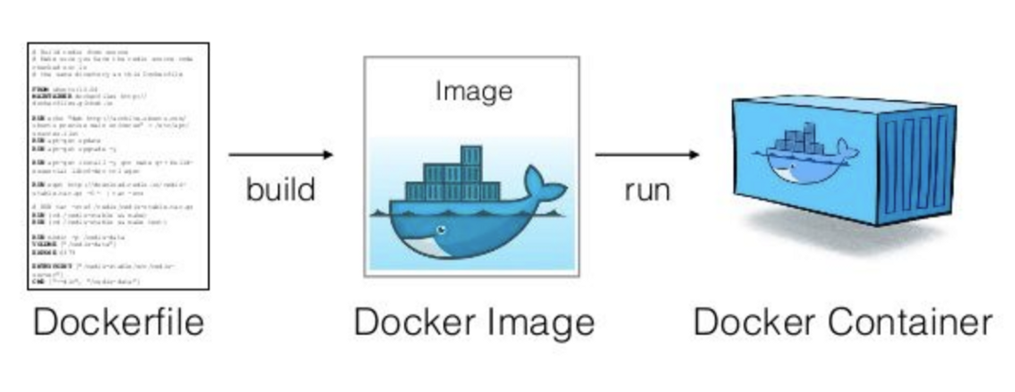
Containerization and Image Deployment
Docker is an open-source platform that allows you to automate the deployment, scaling, and management of applications using containerization. Containers are lightweight, portable, and isolated environments that package an application and its dependencies together.
Advantages:
Eliminates "works on my machine" issues.
Lightweight and scalable deployment.
Supports microservices architecture.

Slide 12
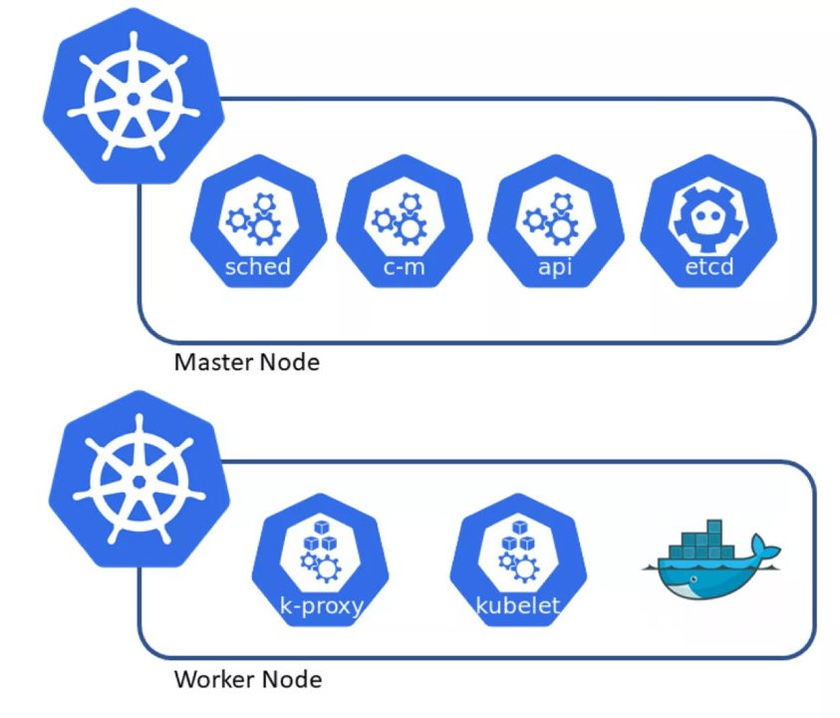
.
Deployment to Kubernetes
Kubernetes manages container orchestration, scaling, and load balancing.
Key features:
Self-healing – Automatically restarts failed containers.
Auto-scaling – Adjusts resources based on demand.
Service discovery & networking – Enables smooth communication between microservices

Slide 13
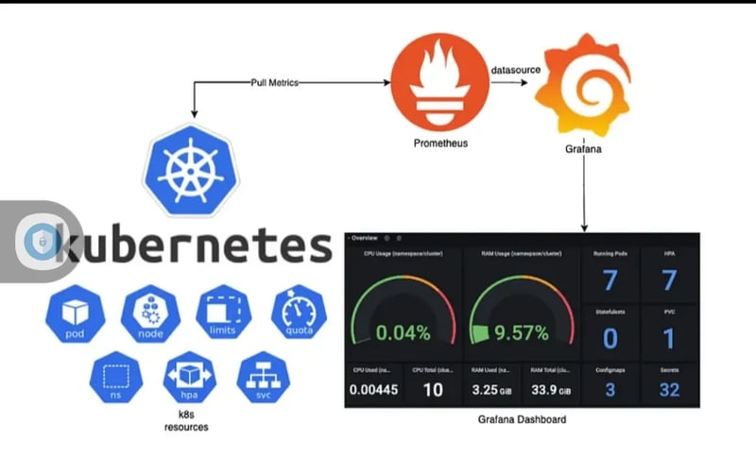
Monitoring and Logging
Prometheus collects time-series metrics from applications and infrastructure.
Grafana visualizes monitoring data with interactive dashboards.
Real-time alerts help detect failures before they impact users.

Slide 14
Challenges and Solutions
Configuration Complexity: Managed using Infrastructure as Code (IaC).
Security Vulnerabilities: Addressed using SonarQube & Trivy.
Scaling Issues: Kubernetes auto-scaling for demand-based adjustments.
Monitoring Overhead: Resolved with Prometheus and Grafana dashboards.

Slide 15
Conclusion
CI/CD automation enhances security, efficiency, and scalability.
Eliminates manual errors and speeds up software delivery.
Kubernetes ensures seamless deployment & monitoring improves reliability.
Future enhancements will make the pipeline even more intelligent and automated.

Slide 16
Future Scope
AI/ML-driven security analysis to predict and mitigate threats.
Multi-cloud deployments for better resilience and cost optimization.
Serverless architecture for lightweight application hosting.
Improved self-healing mechanisms for automated issue resolution.
GitOps for better CI/CD as code management

Slide 17
THANK YOU

